Slide 1
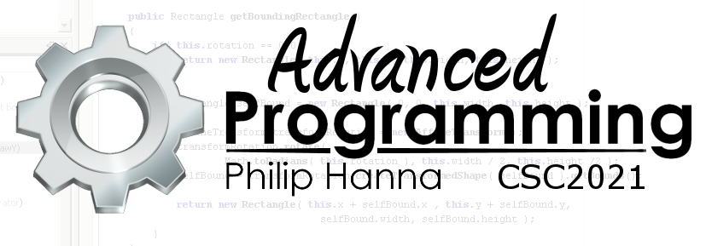
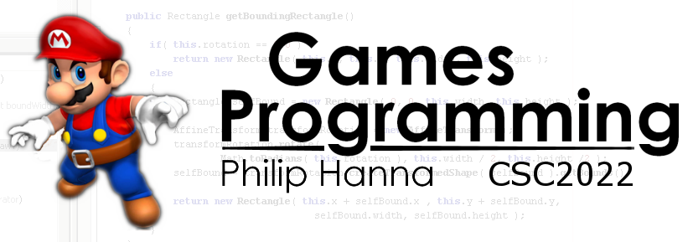
Architectural Design
Identifying and putting together the components of your game

Slide 2

Architectural Design

Slide 3
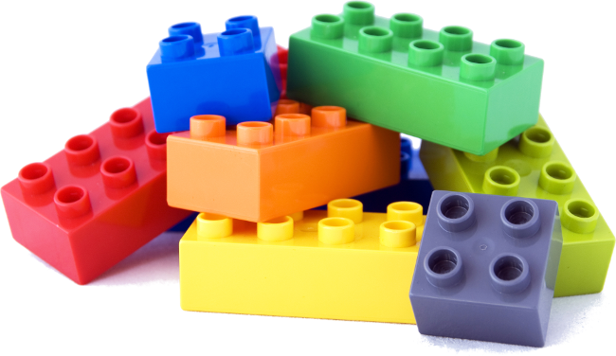
You will want to develop an object oriented design for your program that is intuitive, flexible, extensible and easily maintained.
To help you do this we will explore the notions of object cohesion and coupling and the S.O.L.I.D. design principles.

Slide 4
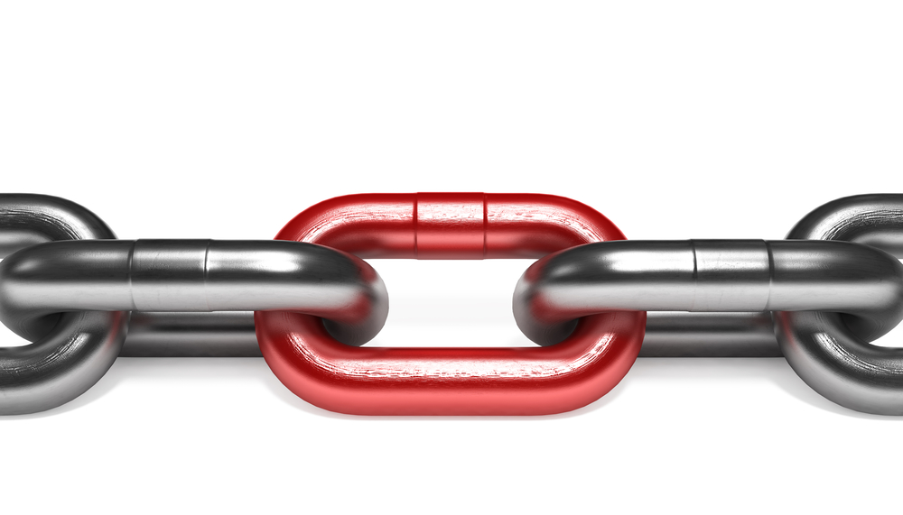
Cohesion and Coupling

Slide 5

Coupling is the degree to which a class (or component) is tied directly to others.
Tight coupling reduces reusability as all classes that are coupled together need to be used (directly or indirectly).
Coupling can be reduced through the use of connecting interfaces between the classes (or components) in the system.

Slide 6

Cohesion is the extent to which parts of the system are related and work well together. For a class, cohesion is increased if the class functionality is consistent and forms a ‘coherent’ whole.
High cohesion is good as it reduces the complexity of the system to the user and increases maintainability as most changes are ‘localised’ to a small number of cohesive components.

Slide 7

Design Principles

Slide 8
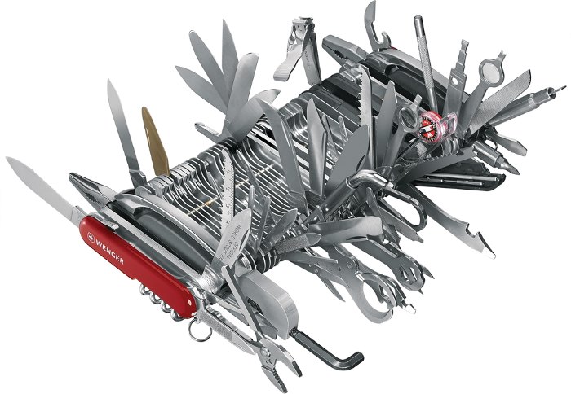
Single Responsibility Principle
"One class should have one and only one responsibility"
A class should be written, changed and maintained with a single purpose in mind, e.g. a class should represent only one actor/entity.
Single responsibility improves the maintainability and extensibility of software.

Slide 9

Open Closed Principle
"Software components should be open for extension, but closed for modification"
A class should be designed so that changes in behaviour or control can be introduced by extending the class and overriding methods. Modifications to the class should not be required.

Slide 10


Liskov’s Substitution Principle
"Derived types must be completely substitutable for their base types"
A class extended from a base class should be able to be used anywhere the base class is used without failure.
If it looks like a duck, quacks like a duck, but needs batteries – you probably have the wrong abstraction.

Slide 11

Interface Segregation Principle
"Clients should not be forced to implement unnecessary methods which they will not use“
Avoid creating interfaces where the developer will be forced to provide one or more method implementations (blank or not) that will never be used.

Slide 12
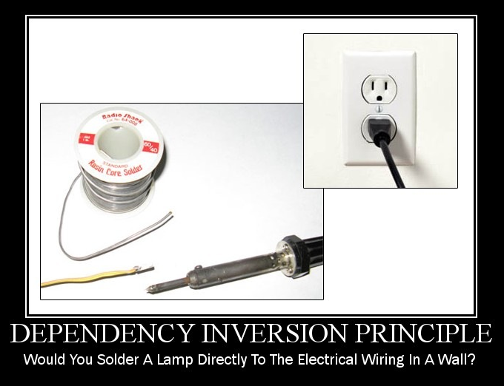
Dependency Inversion Principle
"Depend on abstractions, not on concretions“
Design modules that are separated from each other and use an abstract layer to bind them together.
High-level modules should not depend on low-level modules. Both should depend on abstractions.
By decoupling low-level components from high-level components maintainability and reuse is improved.

Slide 13

Key takeaways:
Good design is underpinned by a small number of sensible design principles.
In practice, design is rarely straightforward. There are typically many possible designs with different positive and negative aspects.

